Slide 1
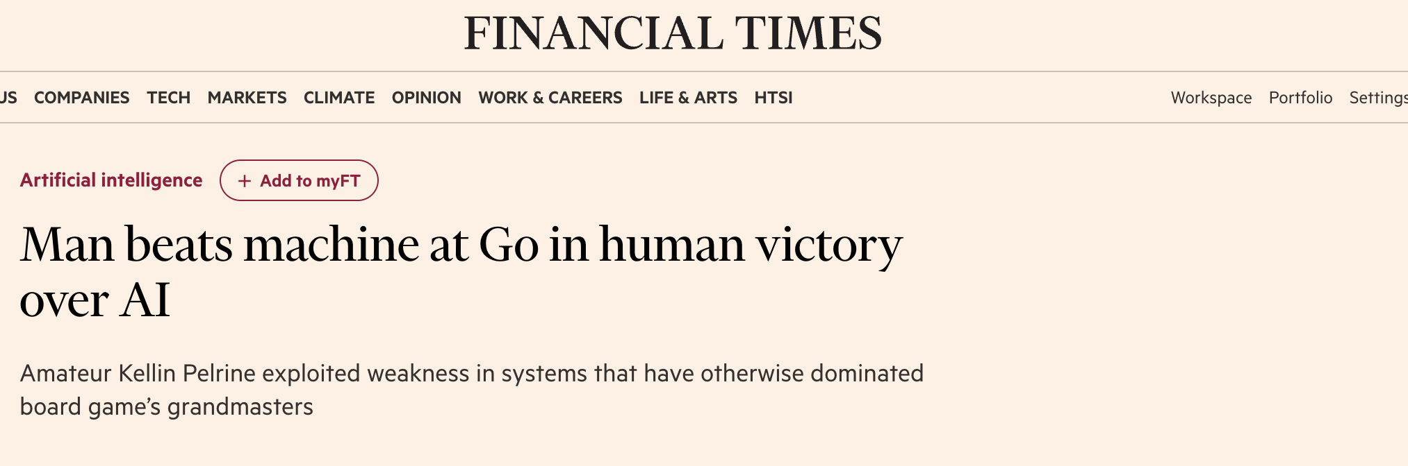
Announcements
Midterm next Monday (March 6) 8-10pm (more details++ on ed)

Slide 2
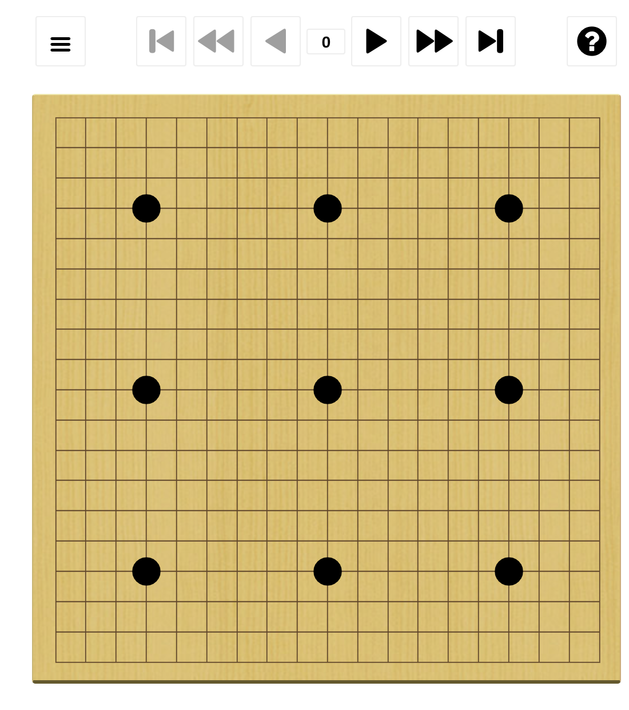
How to beat a superhuman Go program
White: Kellin Pelrine (~2300)
Black: JBXKata005 (~5200)
9-stone handicap

Slide 3

How to beat a superhuman Go program

Slide 4
Q-learning as approximate Q-iteration
Recall the definition of Q values:
Q*(s,a) = expected return from doing a in s and then behaving optimally V(s) = max_{a}Q*(s,a) and π*(s) = argmax_{a}Q*(s,a)
Bellman equation for Q values:
Q*(s,a) = ∑_{s’} T(s,a,s’)[R(s,a,s’) + γ max_{a’} Q*(s’,a’) ]
Approximate Bellman update for Q values:
Q(s,a) ← (1-α) ⋅ Q(s,a) + α ⋅ [R(s,a,s’) + γmax_{a’}Q (s’,a’) ]
We obtain a policy from learned Q(s,a), with no model!
(No free lunch: Q(s,a) table is |A| times bigger than V(s) table)

Slide 5
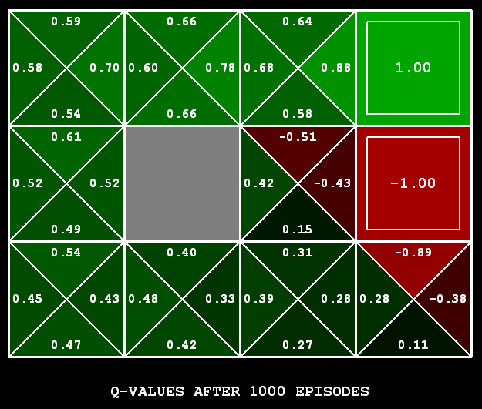
Q-Learning
Learn Q(s,a) values as you go
Receive a sample (s,a,s’,r)
Consider your old estimate: Q(s,a)
Consider your new sample estimate:
sample = R(s,a,s’) + γ max_{a’} Q(s’,a’)
Incorporate the new estimate into a running average:
Q(s,a) ← (1-α) Q(s,a) + α ⋅ [sample]
[Demo: Q-learning – gridworld (L10D2)]
[Demo: Q-learning – crawler (L10D3)]

Slide 6

Video of Demo Q-Learning -- Gridworld

Slide 7
Video of Demo Q-Learning -- Crawler

Slide 8

Q-Learning Properties
Amazing result: Q-learning converges to optimal policy -- even if samples are generated from a suboptimal policy!
This is called off-policy learning
Caveats:
You have to explore enough (eventually try every state/action pair infinitely often)
You have to decrease the learning rate appropriately
Technical requirements: ∑_{t} α(t) = ∞ , ∑_{t} α²(t) < ∞
Satisfied by: α(t) = 1/t or (better) α(t) = K/(K+t)

Slide 9
Summary
RL solves MDPs via direct experience of transitions and rewards
There are several schemes:
Learn the MDP model and solve it
Learn V directly from sums of rewards, or by TD local adjustments
Still need a model to make decisions by lookahead
Learn Q by local Q-learning adjustments, use it directly to pick actions
(and about 100 other variations)
Big missing pieces:
How to explore without too much regret?
How to scale this up to Tetris (10⁶⁰), Go (10¹⁷²), StarCraft (|A|=10²⁶)?

Slide 10
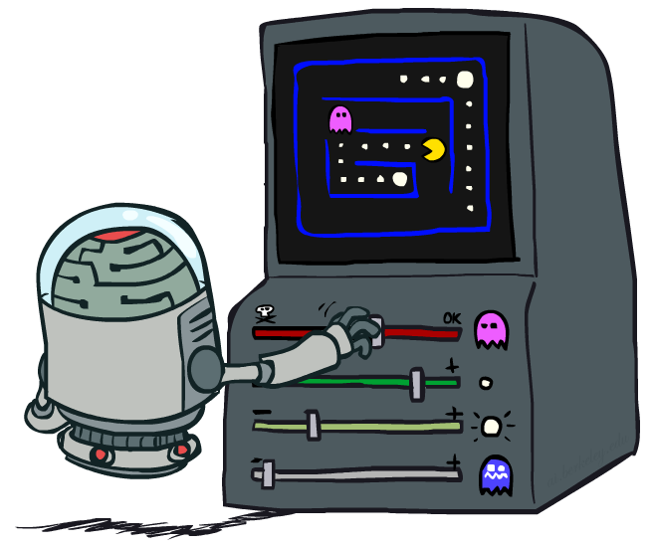
CS 188: Artificial Intelligence
Reinforcement Learning II
Instructors: Stuart Russell and Peyrin Kao
University of California, Berkeley

Slide 11
Reminder: Reinforcement Learning
RL solves MDPs via direct experience of transitions and rewards
There are several schemes:
Learn the MDP model and solve it
Learn V directly from sums of rewards, or by TD local adjustments
Still need a model to make decisions by lookahead
Learn Q by local Q-learning adjustments, use it directly to pick actions
(and about 100 other variations)
Big missing pieces:
How to explore without too much regret?
How to scale this up to Tetris (10⁶⁰), Go (10¹⁷²), StarCraft (|A|=10²⁶)?

Slide 12
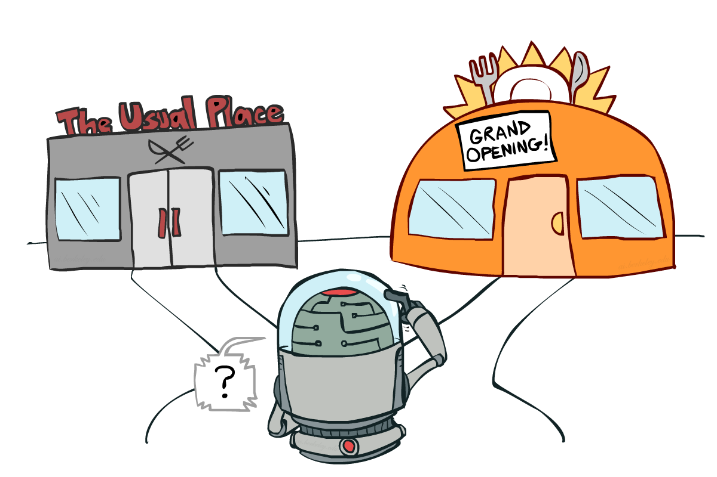
Exploration vs. Exploitation

Slide 13
Exploration vs exploitation
Exploration: try new things
Exploitation: do what’s best given what you’ve learned so far
Key point: pure exploitation often gets stuck in a rut and never finds an optimal policy!

Slide 14

Exploration method 1: ε-greedy
ε-greedy exploration
Every time step, flip a biased coin
With (small) probability ε, act randomly
With (large) probability 1-ε, act on current policy
Properties of ε-greedy exploration
Every s,a pair is tried infinitely often
Does a lot of stupid things
Jumping off a cliff lots of times to make sure it hurts
Keeps doing stupid things for ever
Decay ε towards 0

Slide 15
Demo Q-learning – Epsilon-Greedy – Crawler

Slide 16
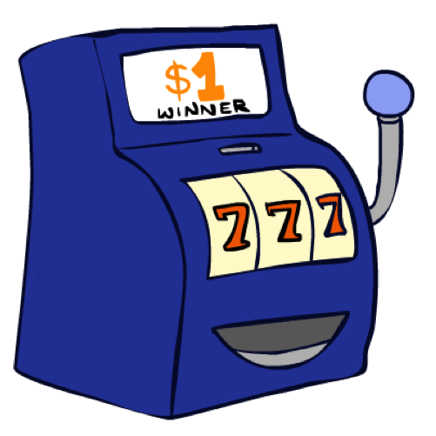
Sensible exploration: Bandits
A
Tries: 1000
Winnings: 900
B
Tries: 100
Winnings: 90
C
Tries: 5
Winnings: 4
D
Tries: 100
Winnings: 0
Which one-armed bandit to try next?
Most people would choose C > B > A > D
Basic intuition: higher mean is better; more uncertainty is better
Gittins (1979): rank arms by an index that depends only on the arm itself

Slide 17
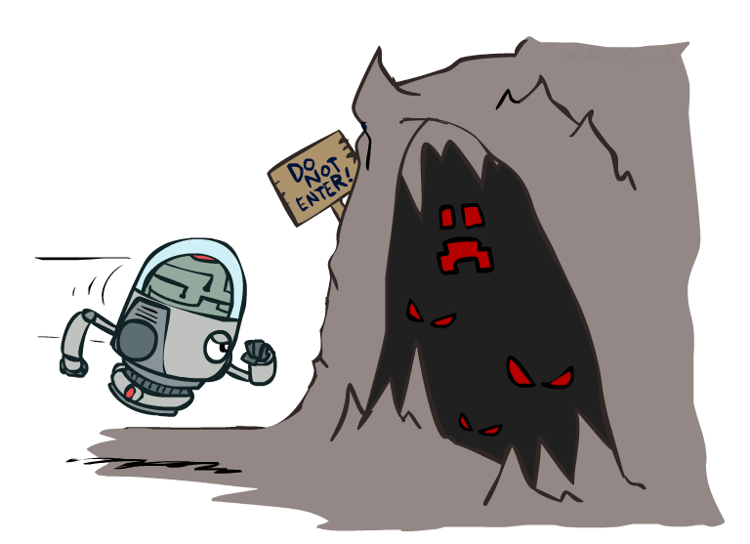
Exploration Functions
Exploration functions implement this tradeoff
Takes a value estimate u and a visit count n, and
returns an optimistic utility, e.g., f(u,n) = u + k/√n
Regular Q-update:
Q(s,a) ← (1-α) ⋅ Q(s,a) + α ⋅ [R(s,a,s’) + γ max_{a}Q (s’,a) ]
Modified Q-update:
Q(s,a) ← (1-α) ⋅ Q(s,a) + α ⋅ [R(s,a,s’) + γ max_{a} f(Q (s’,a),n(s’,a’)) ]
Note: this propagates the “bonus” back to states that lead to unknown states as well!

Slide 18
Demo Q-learning – Exploration Function – Crawler

Slide 19
Optimality and exploration
total reward
per trial
optimal
exploration function
decay ε-greedy
regret
fixed ε-greedy
number of trials

Slide 20
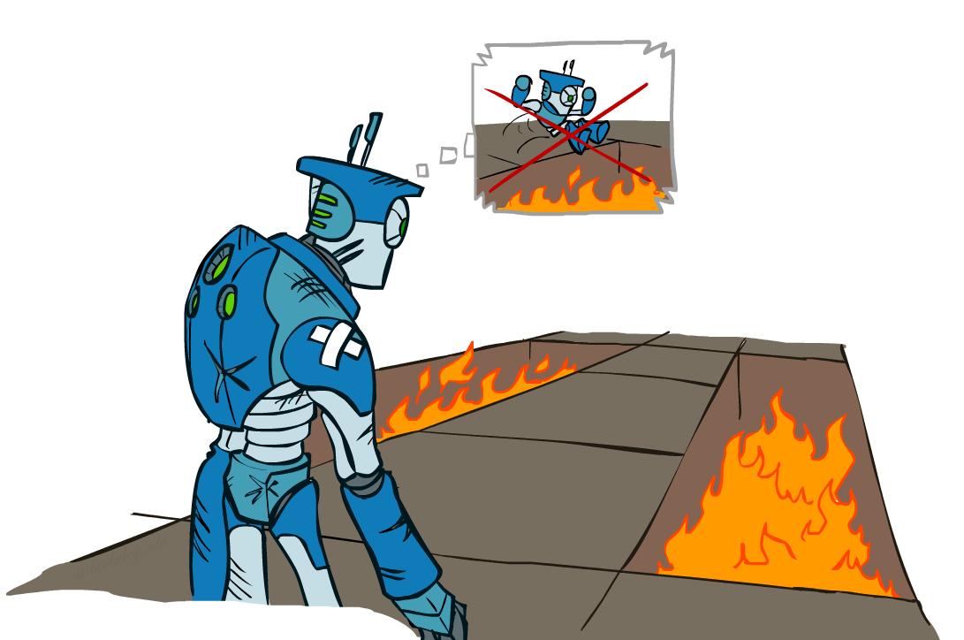
Regret
Regret measures the total cost of your youthful errors made while exploring and learning instead of behaving optimally
Minimizing regret goes beyond learning to be optimal – it requires optimally learning to be optimal

Slide 21
Approximate Q-Learning

Slide 22

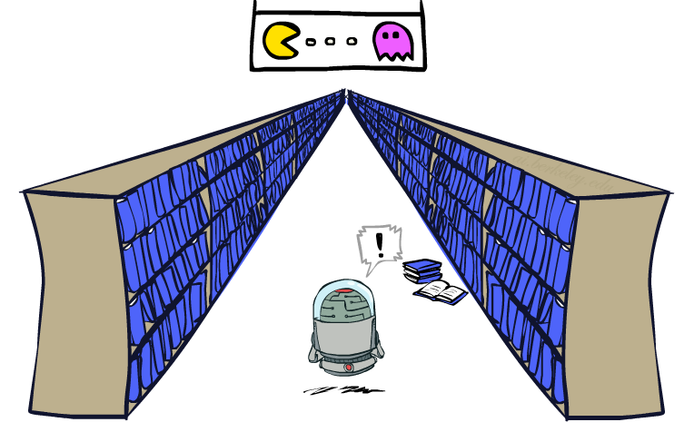
Generalizing Across States
Basic Q-Learning keeps a table of all Q-values
In realistic situations, we cannot possibly learn about every single state!
Too many states to visit them all in training
Too many states to hold the Q-tables in memory
Instead, we want to generalize:
Learn about some small number of training states from experience
Generalize that experience to new, similar situations
Can we apply some machine learning tools to do this?
[demo – RL pacman]

Slide 23
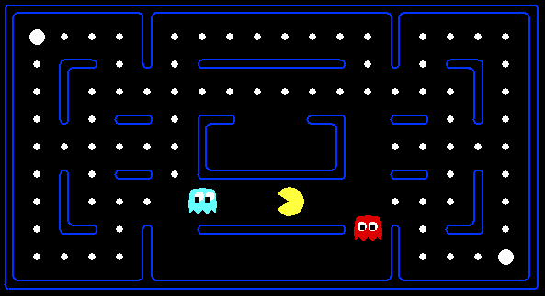



Example: Pacman
Let’s say we discover through experience that this state is bad:
In naïve q-learning, we know nothing about this state:
Or even this one!
Notes:
Diff: missing food near top right-hand corner

Slide 24
Demo Q-Learning Pacman – Tiny – Watch All
Notes:
even for a small board you need a lot of episodes to learn; many pacmen are sacrificed

Slide 25
Demo Q-Learning Pacman – Tiny – Silent Train
Notes:
after 2000 episodes it does well

Slide 26
Demo Q-Learning Pacman – Tricky – Watch All
Notes:
in a larger world it takes a lot longer; in one episode pacman tries hiding, ghost does a victory lap

Slide 27
Feature-Based Representations
Describe a state using a vector of features
Features are functions from states to real numbers (often 0/1) that capture important properties of the state
Example features:
Distance to closest ghost f_{GST}
Distance to closest dot
Number of ghosts
1 / (distance to closest dot) f_{DOT}
Is Pacman in a tunnel? (0/1)
…… etc.
Can also describe a q-state (s, a) with features (e.g., action moves closer to food)

Slide 28
Linear Value Functions
We can express V and Q (approximately) as weighted linear functions of feature values:
V_{w}(s) = w₁f₁(s) + w₂f₂(s) + … + w_{n}f_{n}(s)
Q_{w}(s,a) = w₁f₁(s,a) + w₂f₂(s,a) + … + w_{n}f_{n}(s,a)
With the wrong features, the best possible approximation may be terrible!
But in practice we can compress a value function for chess (10⁴³ states) down to about 30 weights and get decent play!!!

Slide 29
Updating a linear value function
Original Q-learning rule tries to reduce prediction error at s,a:
Q(s,a) ← Q(s,a) + α ⋅ [R(s,a,s’) + γ max_{a’} Q (s’,a’) - Q(s,a) ]
Instead, we update the weights to try to reduce the error at s,a:
w_{i} ← w_{i} + α ⋅ [R(s,a,s’) + γ max_{a’} Q (s’,a’) - Q(s,a) ] ∂Q_{w}(s,a)/∂w_{i}
= w_{i} + α ⋅ [R(s,a,s’) + γ max_{a’} Q (s’,a’) - Q(s,a) ] f_{i}(s,a)
Qualitative justification:
Pleasant surprise: increase weights on +ve features, decrease on –ve ones
Unpleasant surprise: decrease weights on +ve features, increase on –ve ones

Slide 30
Example: Q-Pacman
Q(s,a) = 4.0 f_{DOT}(s,a) – 1.0 f_{GST}(s,a)
f_{DOT}(s,NORTH) = 0.5
a = NORTH
r = –500
s
s’
f_{GST}(s,NORTH) = 1.0
Q(s,NORTH) = +1
Q(s’,⋅) = 0
r + γ max_{a’} Q (s’,a’) = – 500 + 0
w_{DOT} ← 4.0 + α[–501]0.5
difference = –501
w_{GST} ← –1.0 + α[–501]1.0
Q(s,a) = 3.0 f_{DOT}(s,a) – 3.0 f_{GST}(s,a)

Slide 31
Demo Approximate Q-Learning -- Pacman

Slide 32
Convergence*
Let V^{L} be the closest linear approximation to V*.
TD learning with a linear function approximator converges to some V that is pretty close to V^{L}
Q-learning with a linear function approximator may diverge
With much more complicated update rules, stronger convergence results can be proved – even for nonlinear function approximators such as neural nets

Slide 33
Nonlinear function approximators
We can still use the gradient-based update for any Q_{w}:
w_{i} ← w_{i} + α ⋅ [R(s,a,s’) + γ max_{a’} Q (s’,a’) - Q(s,a) ] ∂Q_{w}(s,a)/∂w_{i}
Neural network error back-propagation already does this!
Maybe we can get much better V or Q approximators using a complicated neural net instead of a linear function

Slide 34
Backgammon

Slide 35
TDGammon
4-ply lookahead using V(s) trained from 1,500,000 games of self-play
3 hidden layers, ~100 units each
Input: contents of each location plus several handcrafted features
Experimental results:
Plays approximately at parity with world champion
Led to radical changes in the way humans play backgammon

Slide 36
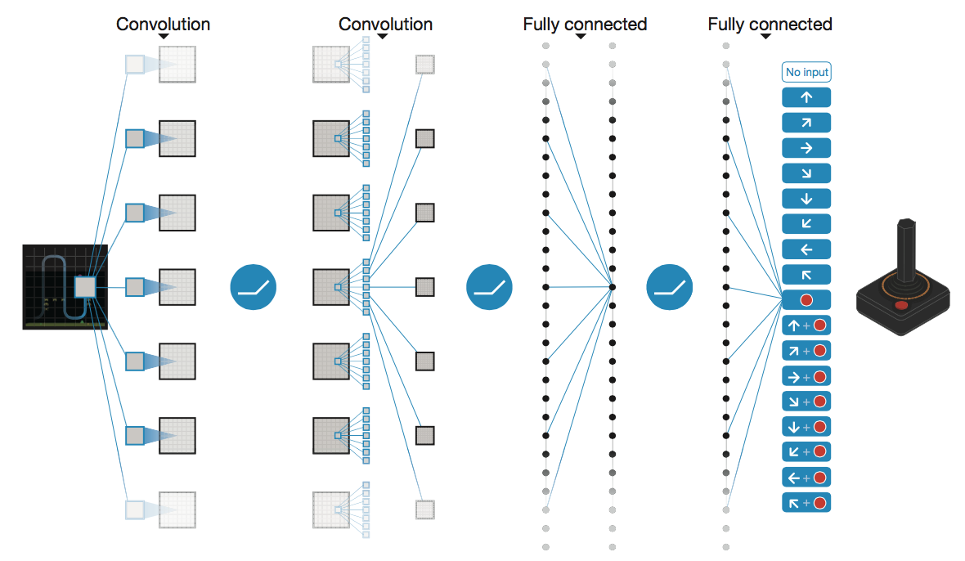
DeepMind DQN
Used a deep learning network to represent Q:
Input is last 4 images (84x84 pixel values) plus score
49 Atari games, incl. Breakout, Space Invaders, Seaquest, Enduro

Slide 37
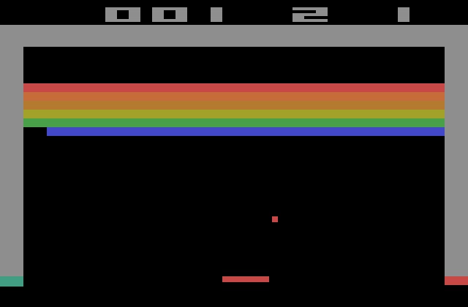
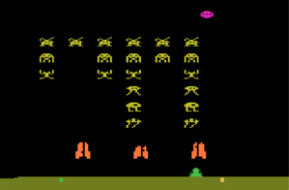
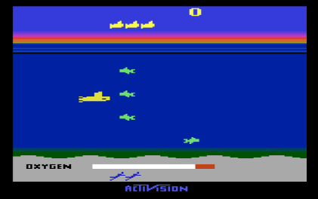
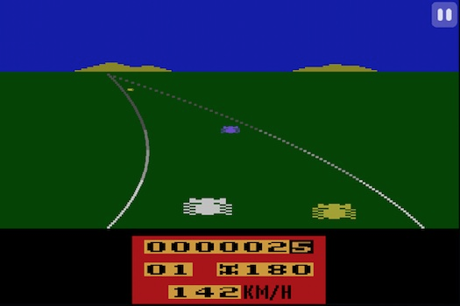

Slide 38
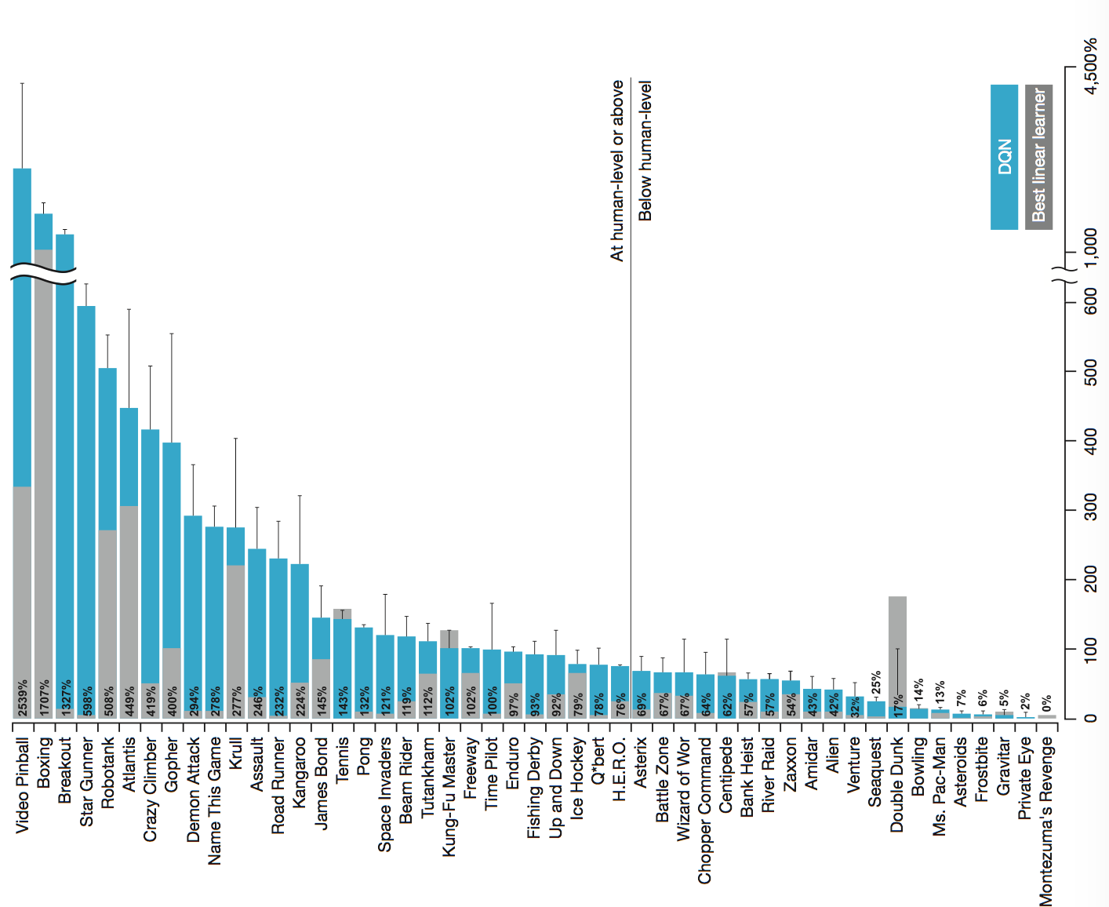
Notes:
Best at video pinball and boxing; 13% at Ms Pacman; pretty good at Enduro (3D racing game)

Slide 39
Summary
Exploration vs. exploitation
Exploration guided by unfamiliarity and potential
Appropriately designed bonuses tend to minimize regret
Generalization allows RL to scale up to real problems
Represent V or Q with parameterized functions
Adjust parameters to reduce sample prediction error

